Slide 1
Basic Spotter Training 2022
NWS State College
NOAA Photo Library

Slide 2
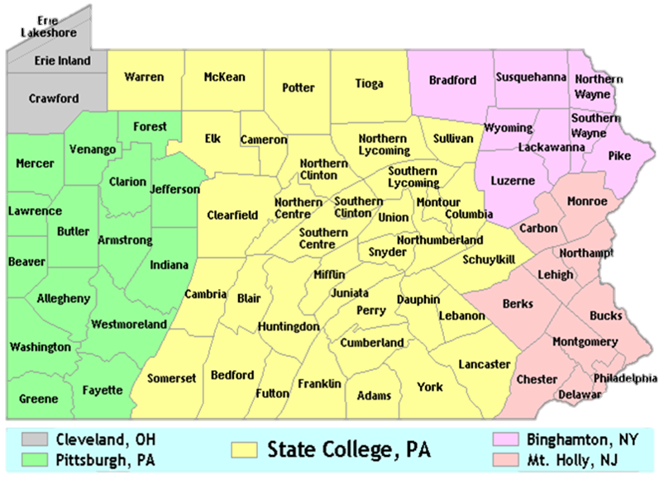
How to Find Us Online
NEW!
@NWSStateCollege
@NWSStateCollege
/NWSStateCollege
/NWSStateCollege
www.weather.gov/ctp

Slide 3
National Weather Service
National Weather Service
Our parent agency is NOAA
National Oceanic and Atmospheric Administration
NWS (and NOAA) fall under the Department of Commerce
Federal agency
Primary Mission:
Provide weather, water and climate data, forecasts, warnings, and impact-based decision support services for the protection of life and property and enhancement of the national economy

Slide 4
Organization of the National Weather Service
9 National Centers (NCEP)
AWC – Aviation Weather Center
CPC – Climate Prediction Center
EMC – Environmental Modeling Center
NCO – NCEP Central Operations
NHC – National Hurricane Center
OPC – Ocean Prediction Center
SPC – Storm Prediction Center
SWPC – Space Weather Prediction Center
WPC – Weather Prediction Center
Local Offices
122 Local Weather Forecast Offices
Five offices serve Pennsylvania
13 River Forecast Centers
Two serve Pennsylvania
6 Regional Offices
Eastern, Central, Southern, Western, Alaska and Pacific
NWS Headquarters
Silver Spring, MD
Notes:
CTP, PBZ, DIX, CLE, BGM … OHRFC, MARFC

Slide 5
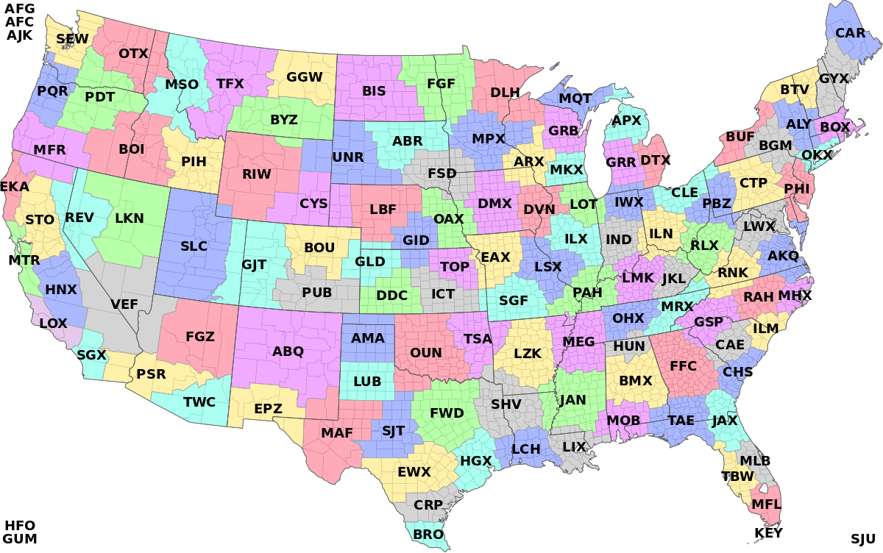
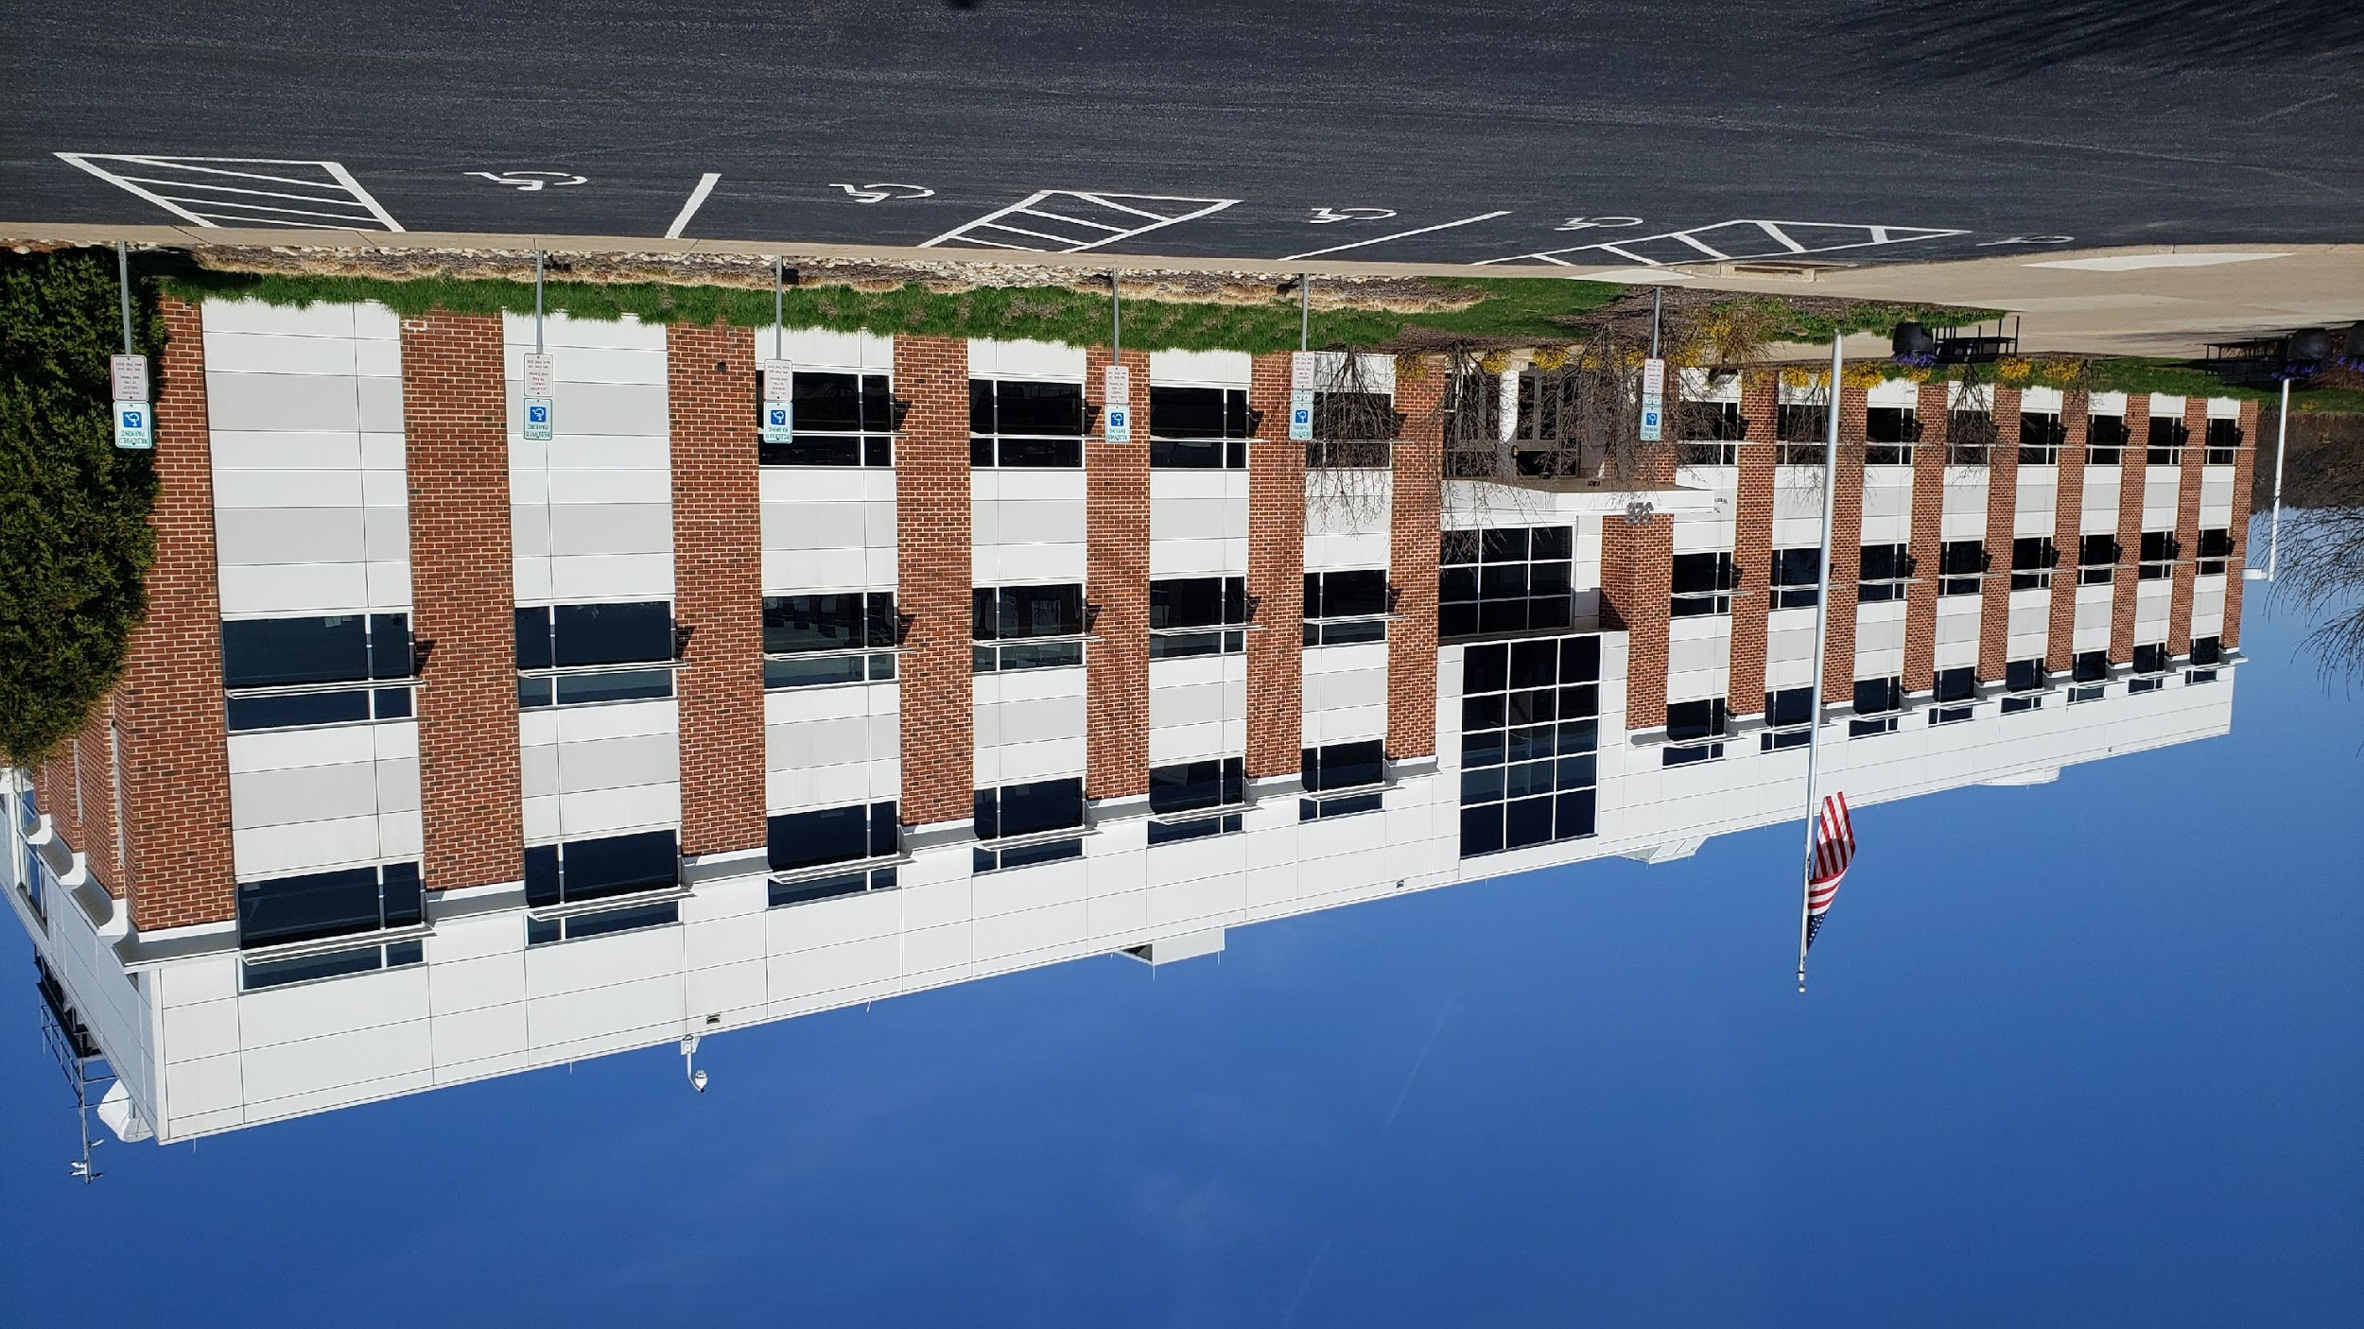
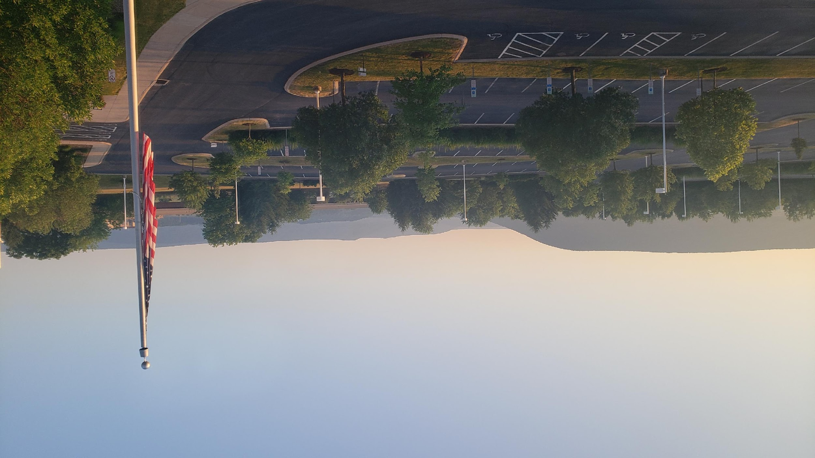
Where are all those Local Offices?
State College

Slide 6
SKYWARN Program
A group of trained volunteers who report hazardous weather in order to:
Supplement remote sensing equipment
Provide real-time ground truth reports
Add credibility to NWS products and services
SKYWARN Spotters act as thousands of “eyes and ears” out in the field, supporting our forecast and warning program!

Slide 7
SKYWARN Program
NWS State College has over 3,000 trained spotters
State-Wide, there are about 10,000 spotters
Nationally, there are nearly 300,000 trained spotters!
Note: Although you are receiving your training today from the State College office, your training is portable
If you move, contact your new “local” office and we can start the process to transfer your credentials

Slide 8
Poll Question
When was the last time you took a SKYWARN training course?
This is my first time
Within the last 2 years
2-4 years ago
4-8 years ago
>8 years ago

Slide 9
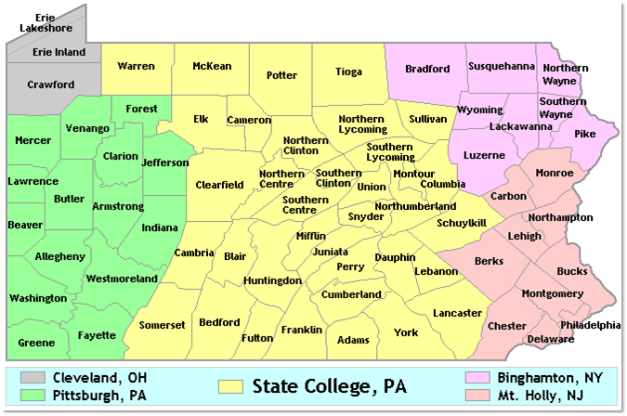
NWS Offices Serving Pennsylvania
Binghamton, NY
Cleveland, OH
State
College, PA
Pittsburgh, PA
Philadelphia/
Mt. Holly, NJ

Slide 10
A look at the Local Office
NWS State College Central PA Weather Forecast Office
Where forecasts are created!
14 Forecasters
6 Electronic Technicians/IT Support
1 Hydrologist
1 Science & Operations officer
1 Observations Program Leader
1 Warning Coordination Meteorologist
1 Administrative Assistant
1 Meteorologist In Charge
Open 24x7x365 to provide forecasts and warnings, as well as maintain the Doppler radar and other observation systems

Slide 11
How We “typically” Work
Short Term
Long Term
Public Service
0-24 hours (maybe 36 hour forecast)
Often staffed by the Lead Forecaster
Warning decisions, aviation support, staffing, etc.
Day 2 – Day 7
Looking at longer term models
Often doing Decision Support duties
Phones, Product QC, NOAA Weather Radio, Social Media

Slide 12
When the weather “ramps up”
Storm Coordinator
Short Term Forecaster
Social Media
Decision Support Meteorologist
Long Term Forecaster
Radar and Warning Team
Public Service

Slide 13
Radar Basics

Slide 14
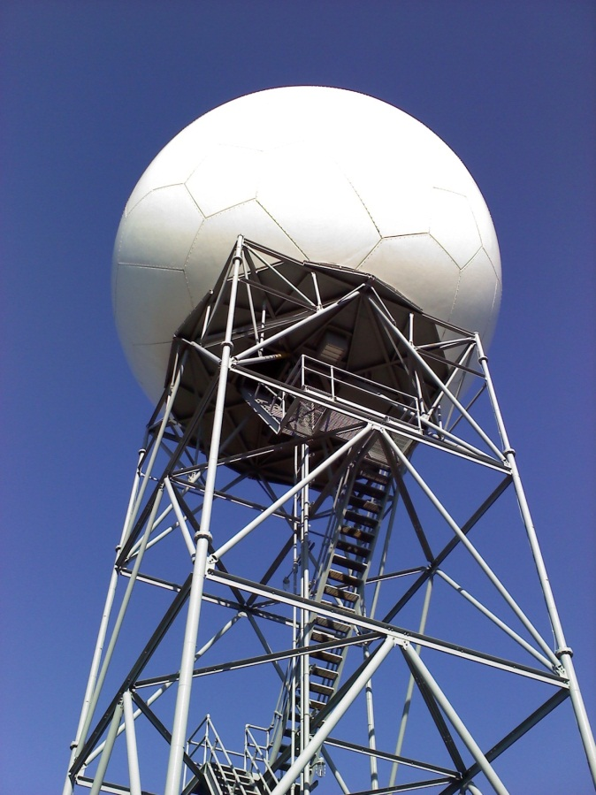
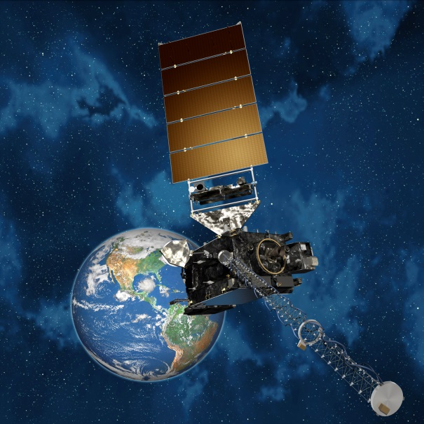
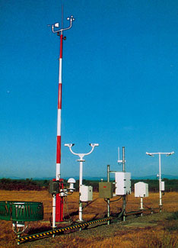
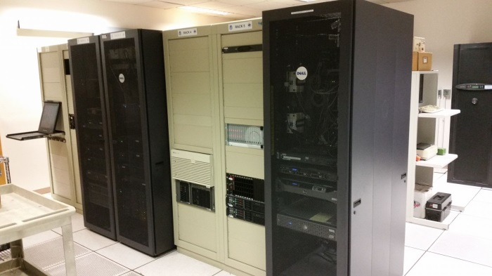
Key Pieces of Equipment
Satellites
Doppler Radar
Remote Sensing
Equipment
Computers

Slide 15
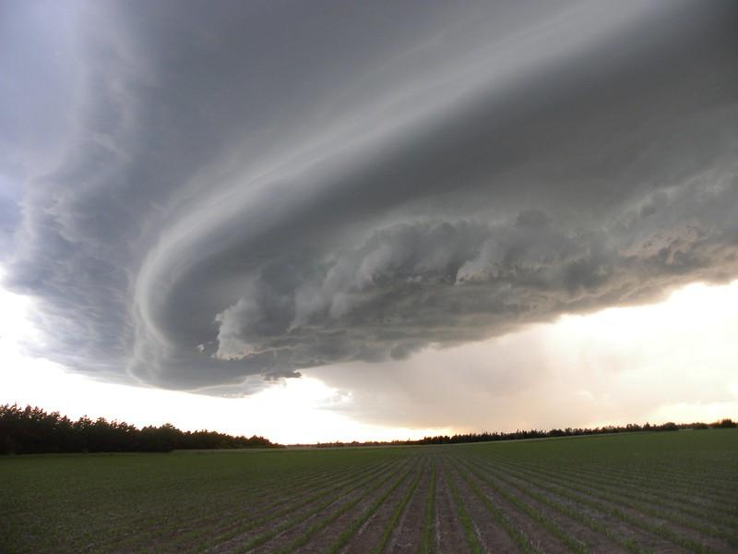
SKYWARN Program Background

Slide 16
SKYWARN Program
Today’s class will cover basic aspects of observing weather, and emphasize the accurate reporting of those observations
Review of some key definitions
A look at different weather elements
When the course is complete, you will be a certified member of the national SKYWARN Team!

Slide 17
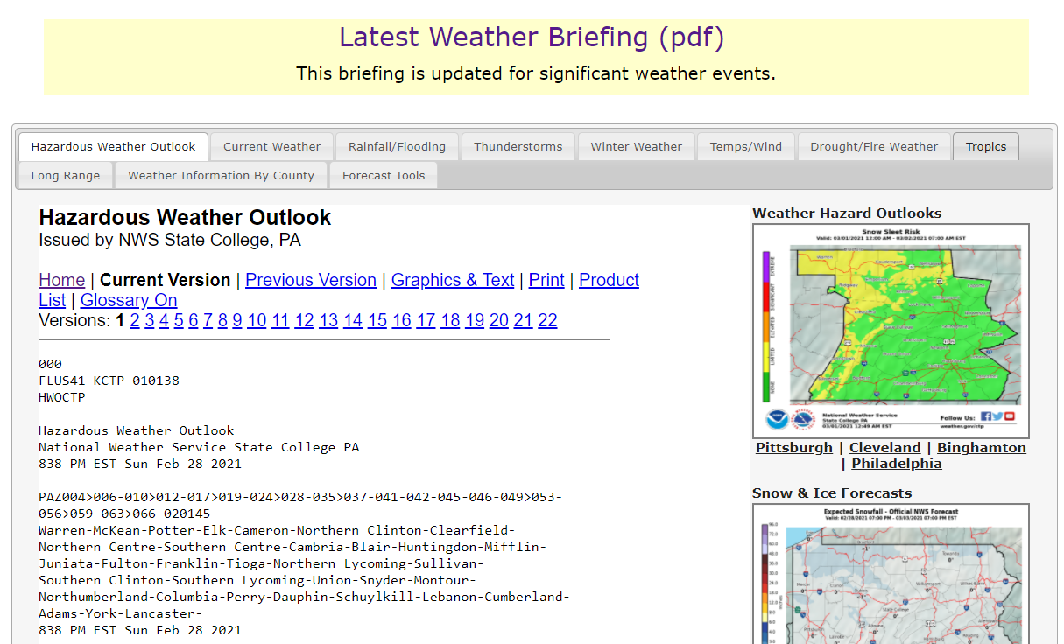
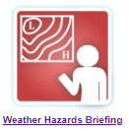
NWS State College Online Resources
BRIEFING PAGE
www.weather.gov/ctp/briefing
or click this icon at the bottom of the NWS CTP home page:
One-stop shop for all NWS forecast information.

Slide 18
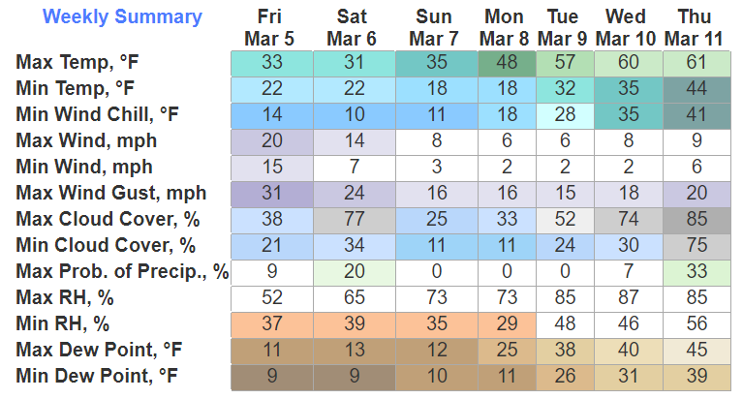
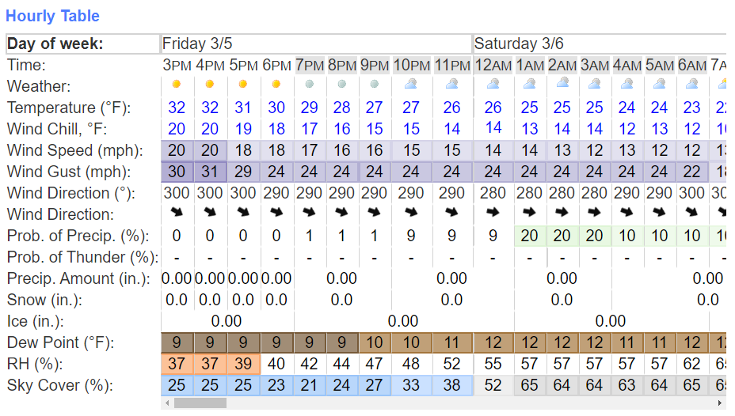
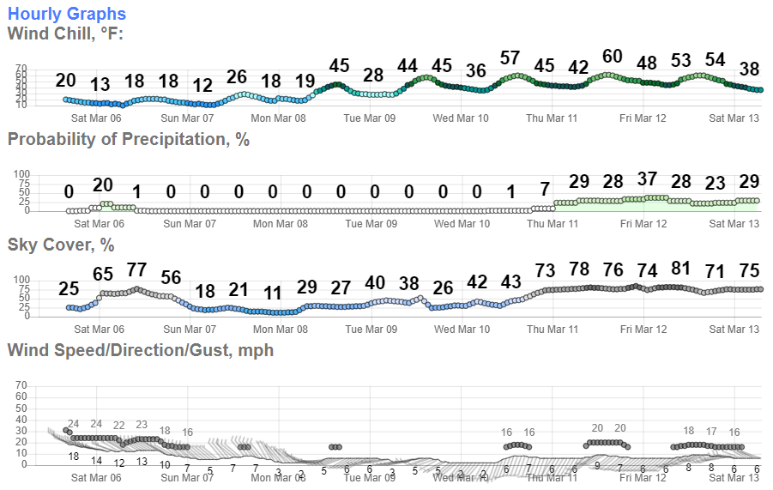
NWS State College Online Resources
FORECAST PAGE
www.weather.gov/forecastpoints
Type in zip code and then click “Bookmark”
Best graphical display of NWS forecast information available.

Slide 19
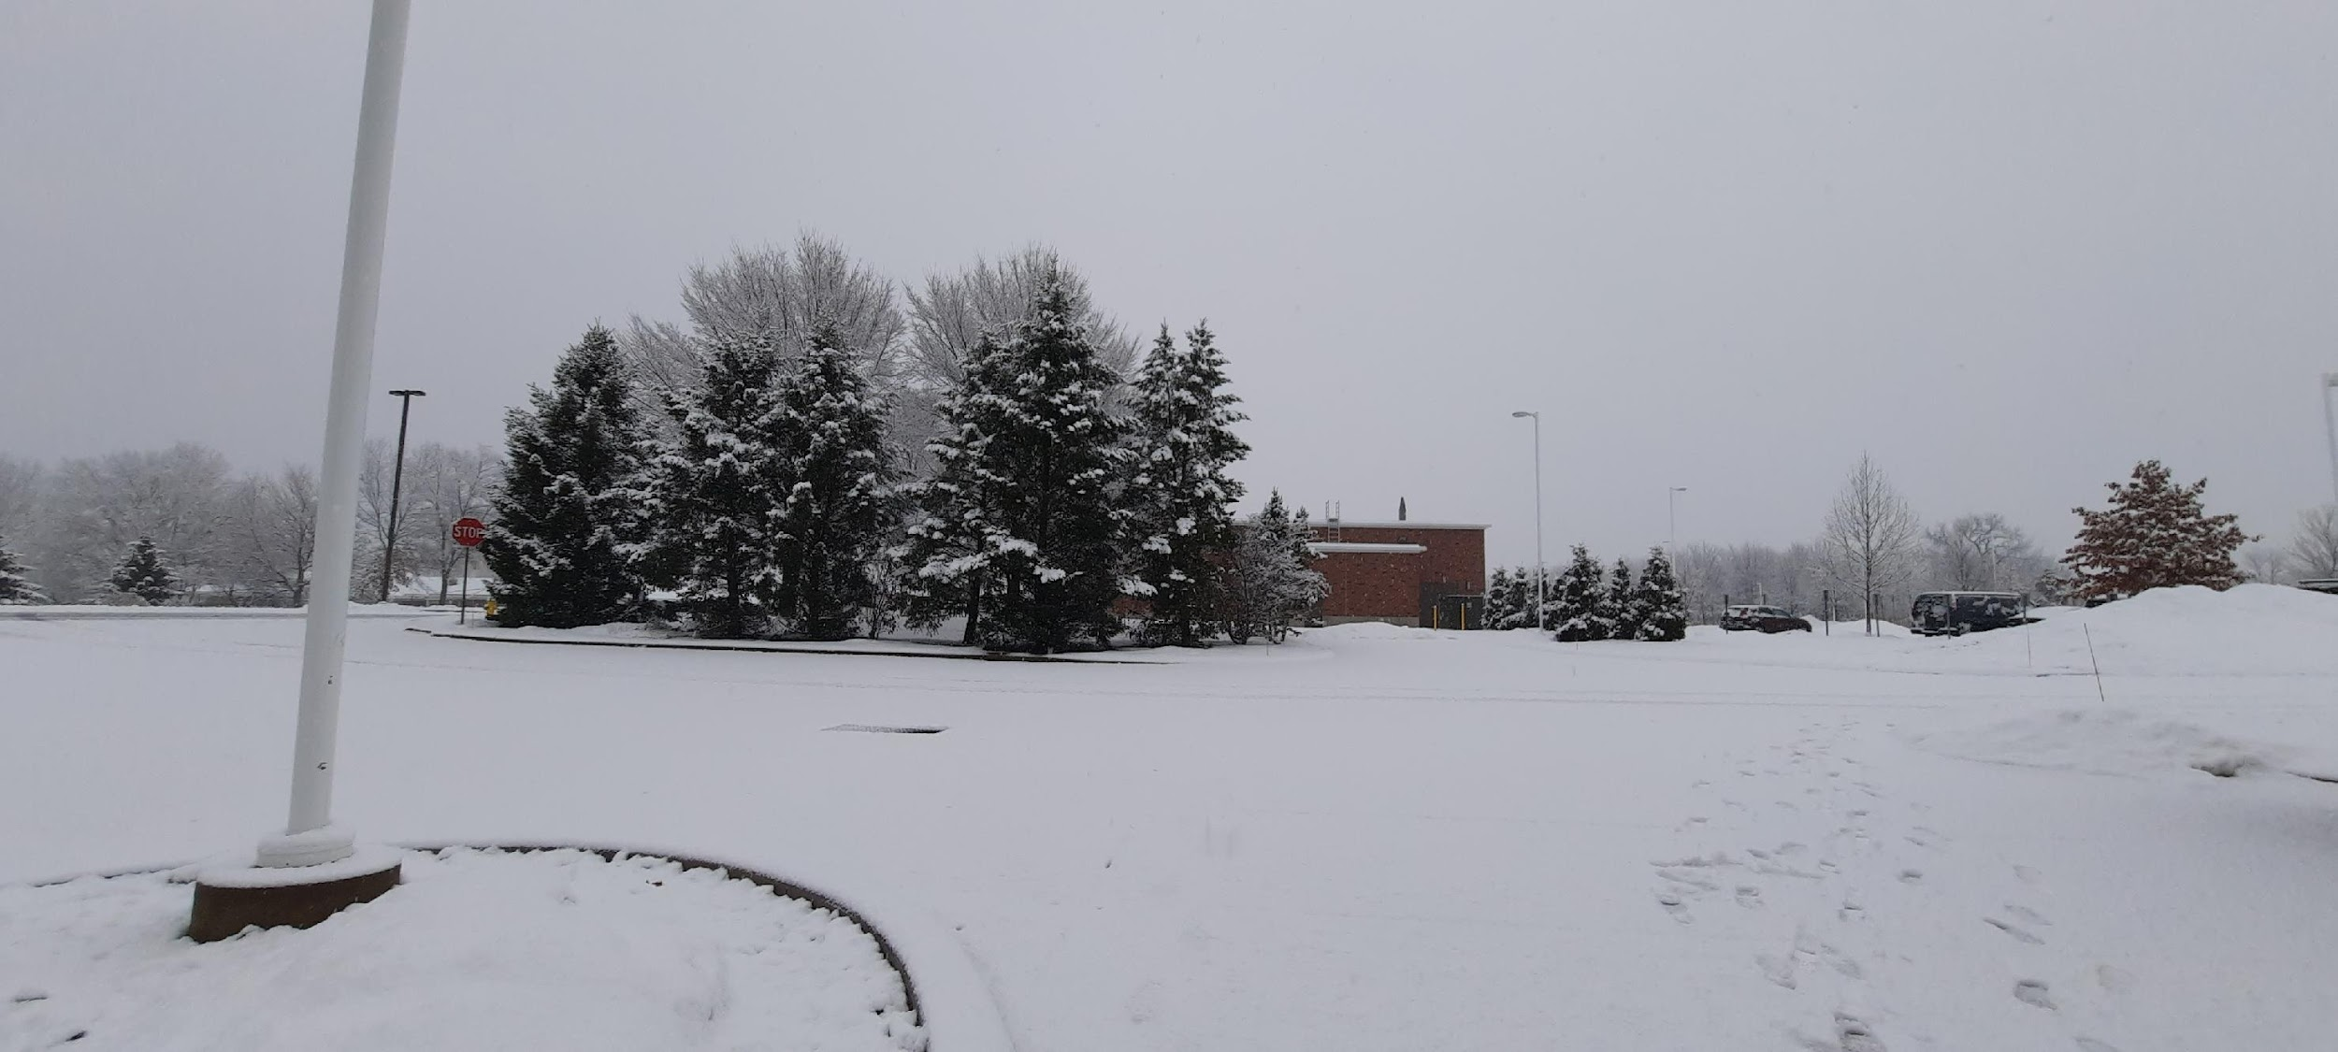
Winter Weather
Winter weather reporting is an important part
of the SKYWARN program
We’ll briefly review how to measure snowfall
“The National Weather Service Way”

Slide 20
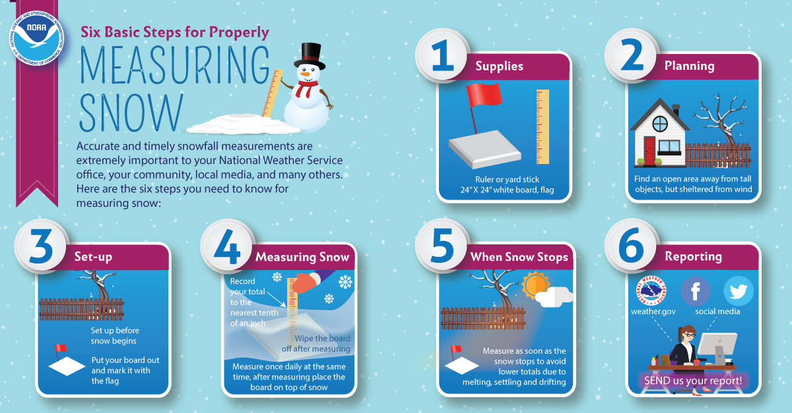
SNOW
Or, measure up to 4x a day, wiping the snowboard clean no more than once every 6 hours

Slide 21
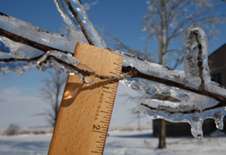
ICE
MEASURING
ICE
Accurate ice reports are needed from spotters so forecasters can assess the forecast in real time, adjust as necessary, and message increasing/decreasing threat.
Freezing rain can lead to widespread significant impacts including dangerous travel and widespread power outages.
1/4 inch
When rain falls with air and surface temperatures at or below 32°F, a fraction of the rain will freeze onto surfaces.
Branch
Example:
¾” ice on bottom +
¼” ice on top = 1”
then divide by 2
Total Ice = ½”
Do not include
Accretion efficiency depends on a variety of factors including rainfall intensity and wind. Light rain, cold air, and strong winds lead to the highest ice-to-liquid ratios.
Ice
3/4 inch

Slide 22
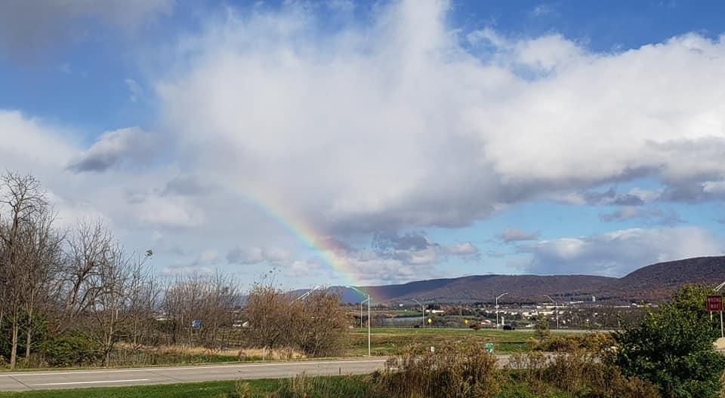
NWS Products
Watches, Warnings, and Advisories

Slide 23
NWS Products: A 3–Tiered Approach
Outlooks
Time
To
Event
Watches
Warnings
Confidence in the forecast

Slide 24
Outlook vs. Watch vs. Warning
OUTLOOK: possible weather event in the future
Lower confidence... a ???? chance of occurrence
Lead time can range from about 3 to 7 days
No details, either in timing or severity...just a “heads-up”
WATCH: Conditions are favorable for a given weather event
Still not a Certainty...in fact the chances of occurrence are ????
Lead Time can range in time from a few hours to several days
Some Watches will result in bad weather...some will not.
WARNING: Conditions imminent (or extremely likely) for a given weather event
Not necessarily 100% certainty, but getting there ????
Lead Time can range from a few minutes (Severe) to about a day (Flood, Winter)
30 - 49%
50 - 79%
> 80%
Notes:
This slide has NO animations. Use for webinars.

Slide 25
Outlook vs. Watch vs. Warning
OUTLOOK: possible weather event in the future
Lower confidence... a ???? chance of occurrence
Lead time can range from about 3 to 7 days
No details, either in timing or severity...just a “heads-up”
WATCH: Conditions are favorable for a given weather event
Still not a Certainty...in fact the chances of occurrence are ????
Lead Time can range in time from a few hours to several days
Some Watches will result in bad weather...some will not.
WARNING: Conditions imminent (or extremely likely) for a given weather event
Not necessarily 100% certainty, but getting there ????
Lead Time can range from a few minutes (Severe) to about a day (Flood, Winter)
30 - 49%
50 - 79%
> 80%
Notes:
This slide HAS animations. Use for in-person talks.

Slide 26
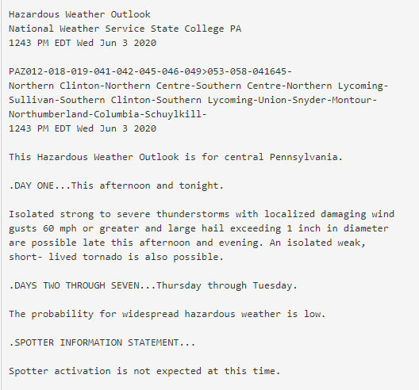
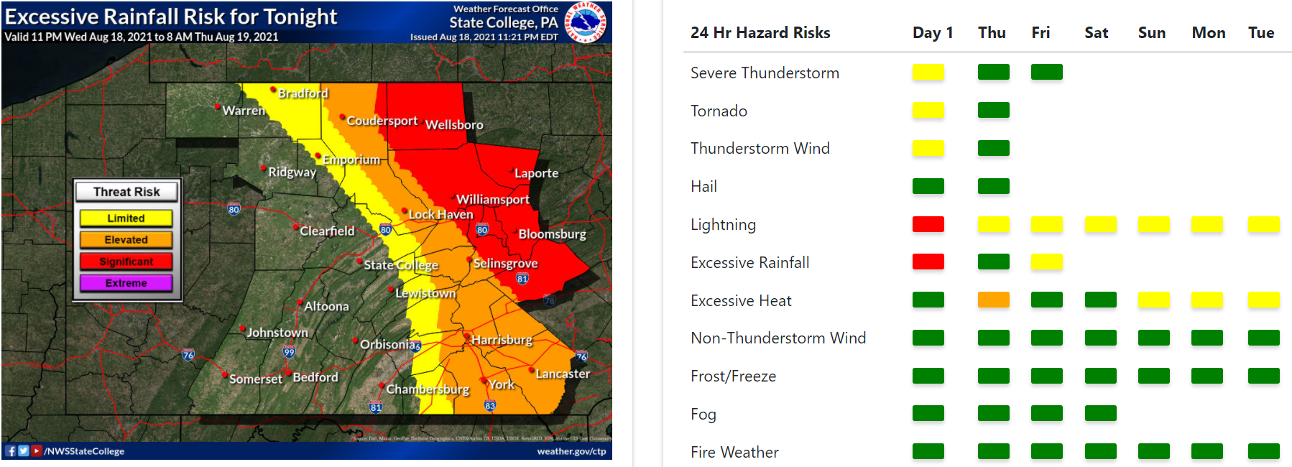
Product Guide - Outlook
HWO (Hazardous Weather Outlook)
https://www.weather.gov/erh/ghwo?wfo=ctp

Slide 27
Severe Weather Outlooks
www.spc.noaa.gov

Slide 28
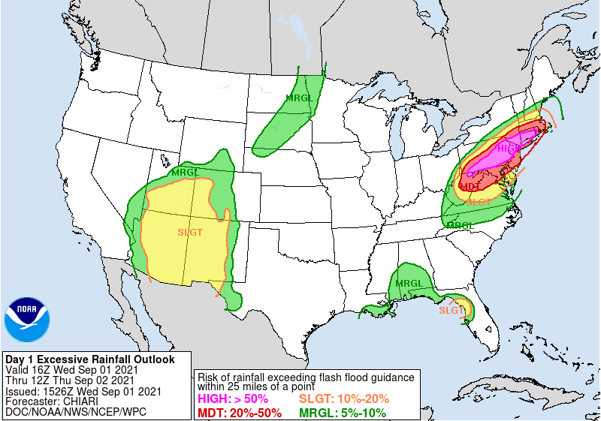
Excessive Rainfall Outlooks
www.spc.noaa.gov

Slide 29
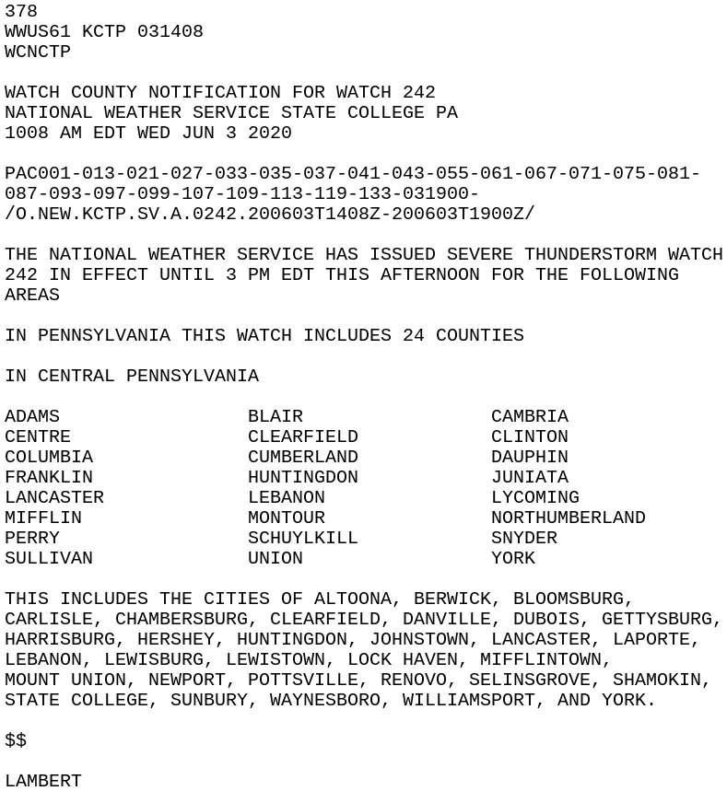
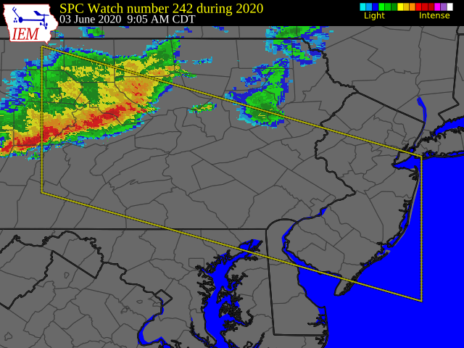
Product Guide - Watch

Slide 30
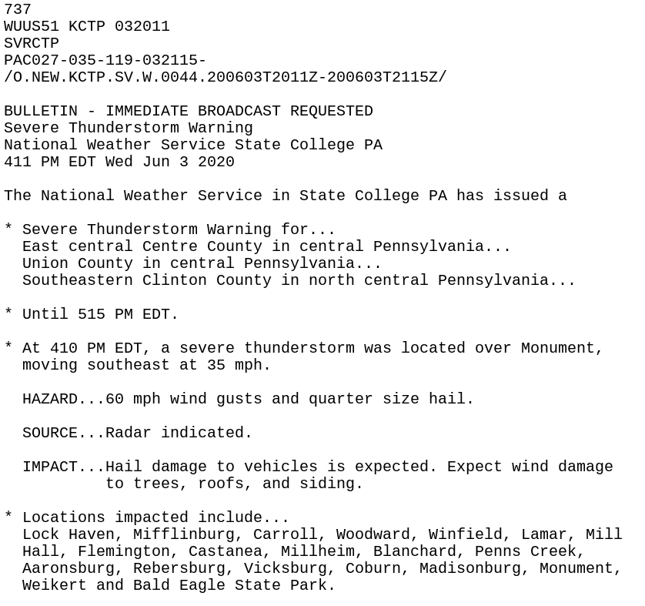
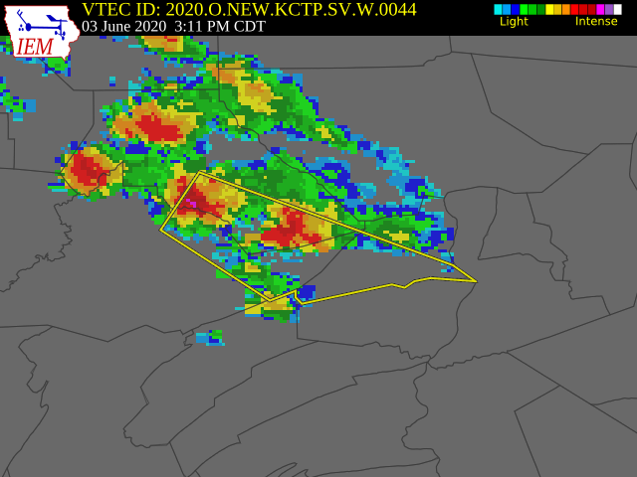
Product Guide - Warning

Slide 31
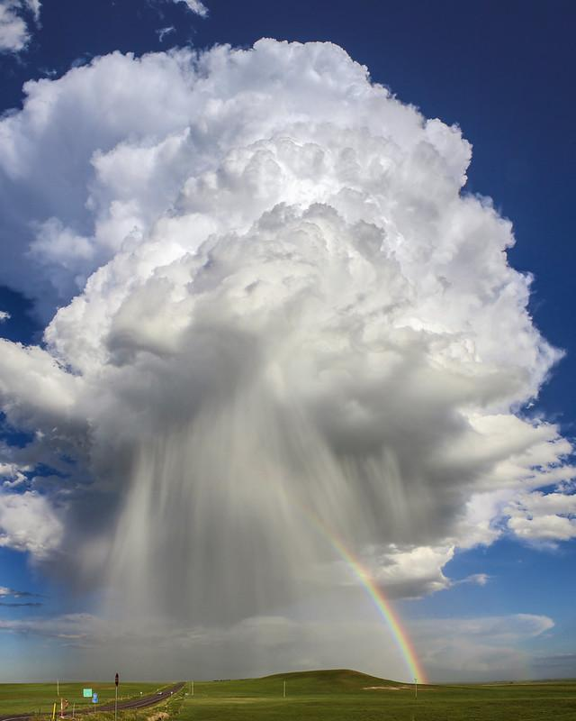
Severe Thunderstorms

Slide 32
Severe Thunderstorms
What makes a thunderstorm severe?
Winds ≥ 58 mph (50 knots)
Hail ≥ 1 inch in maximum dimension
Tornado
Other threats:
Lightning
Flooding

Slide 33
What about those sub-severe storms?
SPECIAL WEATHER STATEMENTS can be issued for storms that may have some impacts, but do not meet severe criteria
Can be issued for thunderstorms producing:
Winds of 30-55 mph
Pea to Nickel sized hail
These will not set off tone alerts or EAS, and rarely trigger phone apps.

Slide 34
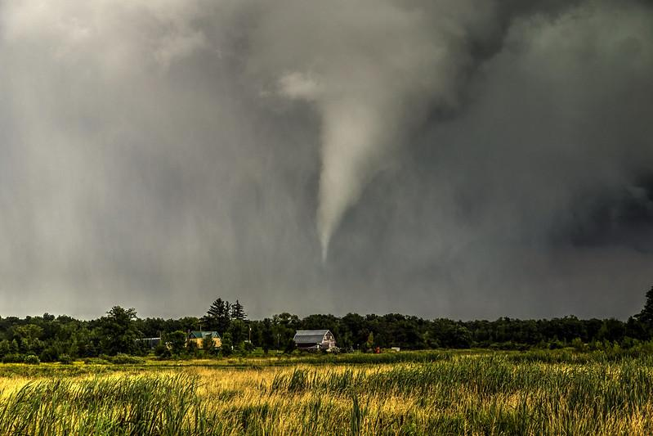
Thunderstorm Ingredients

Slide 35
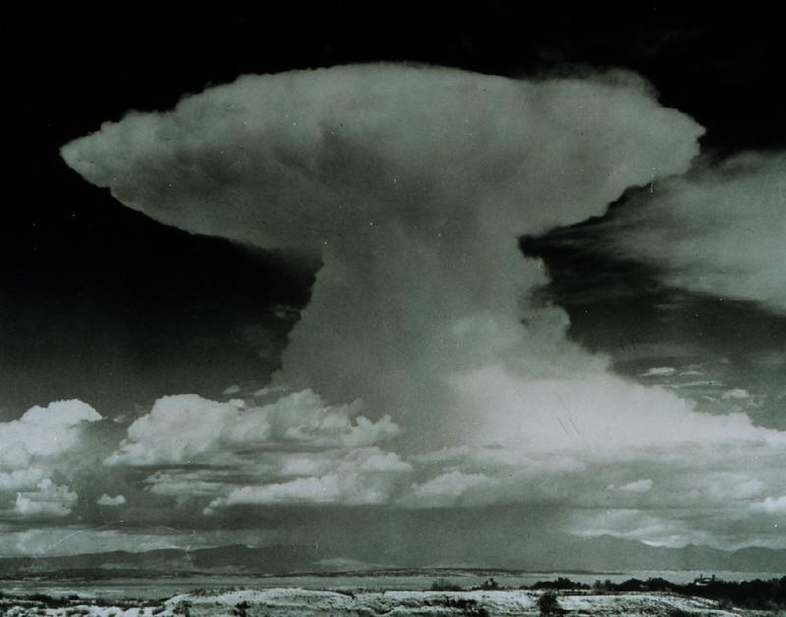
Thunderstorm Ingredients
Instability
Moisture
Lift
Most severe storms also require wind shear
NOAA Photo Library

Slide 36
Thunderstorm Ingredients: Instability
Hot air rises. How do we get hot air?
Sun heats the ground → ground heats the air
The larger the temperature difference between the surface and the air above, the greater the instability
Instability is maximized on warm, sunny days with abnormally cold air aloft
Ground heats air
Sun heats ground

Slide 37
Thunderstorm Ingredients: Moisture
Moisture is needed to form clouds and precipitation
Moisture increases instability (CAPE). Why?
When water vapor in a rising parcel of air condenses to form cloud droplets, the parcel of air is warmed relative to its surroundings
This warming enhances instability

Slide 38
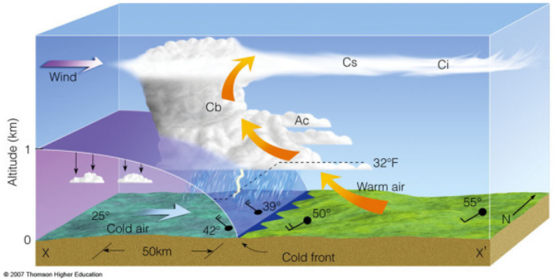
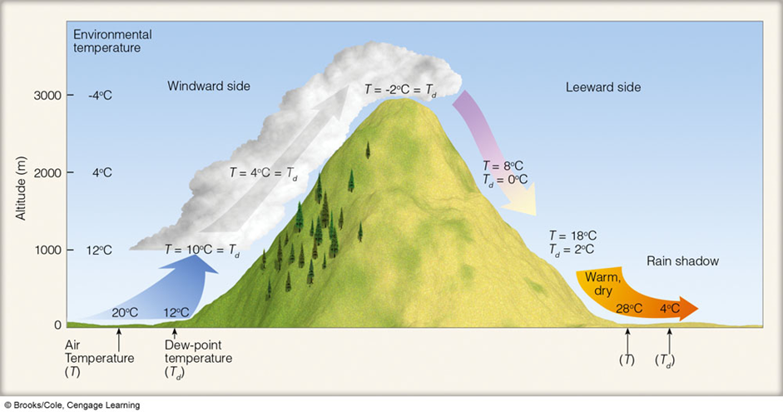
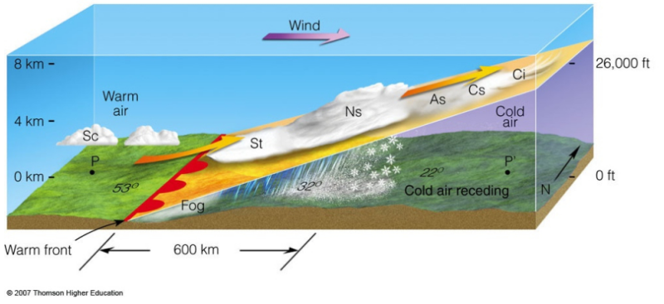
Thunderstorm Ingredients: Lift
Forced ascent (lift) is needed to create thunderstorms
What can force air to rise?
Cold Fronts
Warm Fronts
Mountains

Slide 39
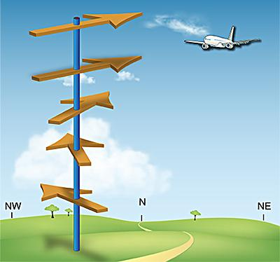
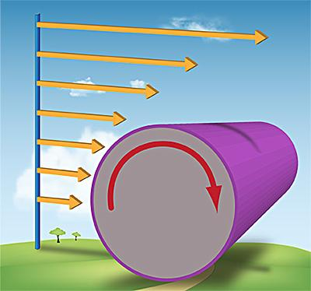
Thunderstorm Ingredients: Wind Shear
Speed Shear
Directional Shear
Wind direction changes with height
Wind speed changes with height

Slide 40
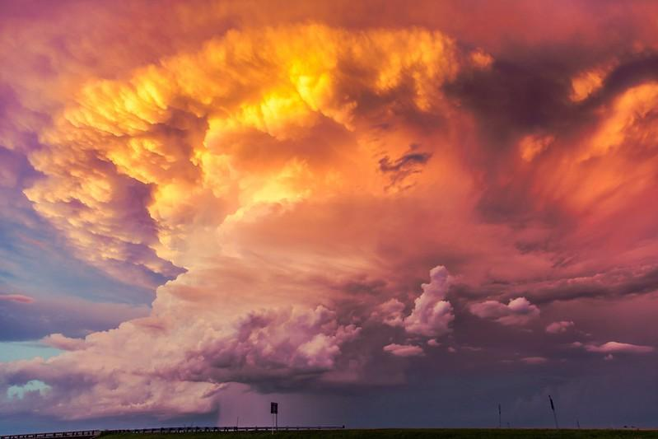
Thunderstorm Ingredients: Wind Shear
Low Wind Shear → Rain falls through updraft, killing the short-lived storm. Lower chance for severe weather.
High Wind Shear → Rain falls downwind of updraft and updraft remains intact. Higher chance for severe weather.

Slide 41
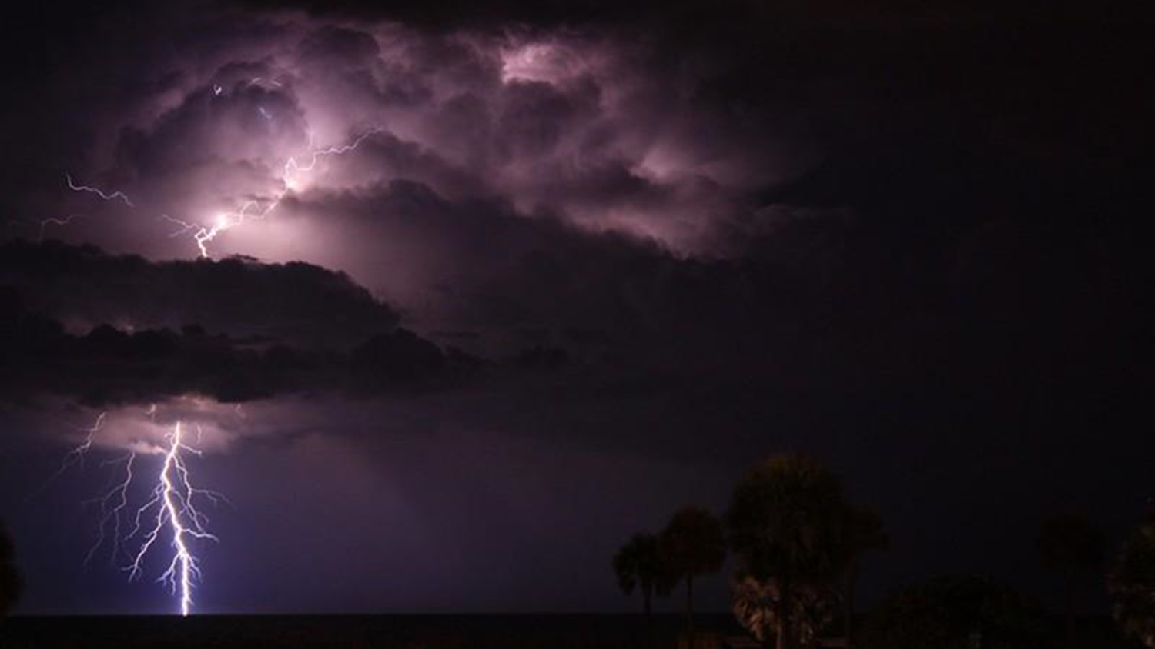
Types of Thunderstorms

Slide 42
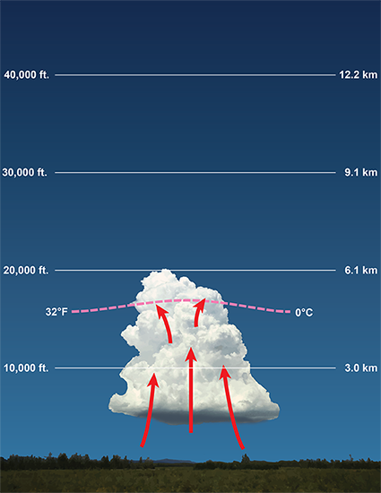
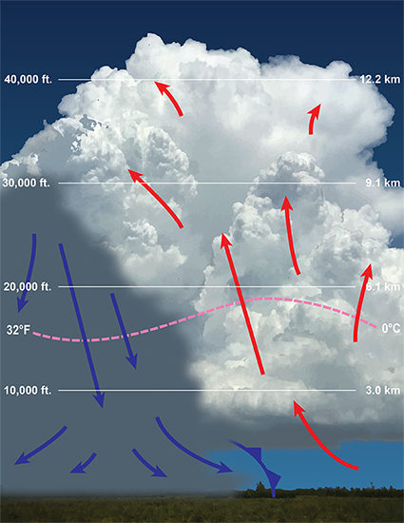
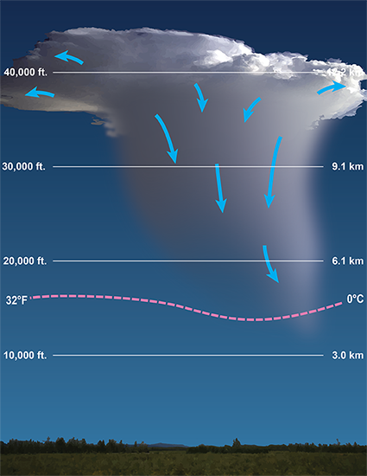
Ordinary Thunderstorms
Towering Cumulus
Mature Storm
Dissipation
Notes:
https://www.weather.gov/jetstream/life

Slide 43
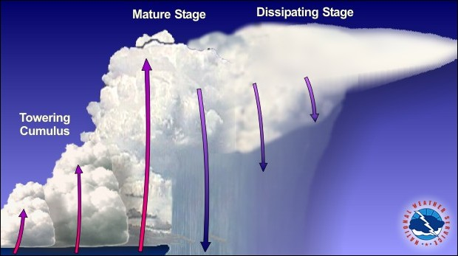
Multi-cell Thunderstorms
Upper-level winds carry the first cell downstream with a new cell forming upwind of the previous cell.
If the upper-level wind is opposite of the low-level winds, backbuilding can develop – leading to flash flooding.
A line of multi-cell thunderstorms is called a squall line.
Multi-cell Cluster
Notes:
https://www.weather.gov/jetstream/life

Slide 44
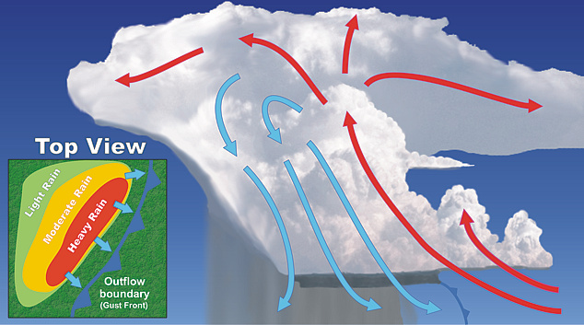
Squall Lines
New cells continually reform at the leading edge of a cold pool.
Updrafts and downdrafts along the line can become strong, resulting in large hail and damaging winds.

Slide 45
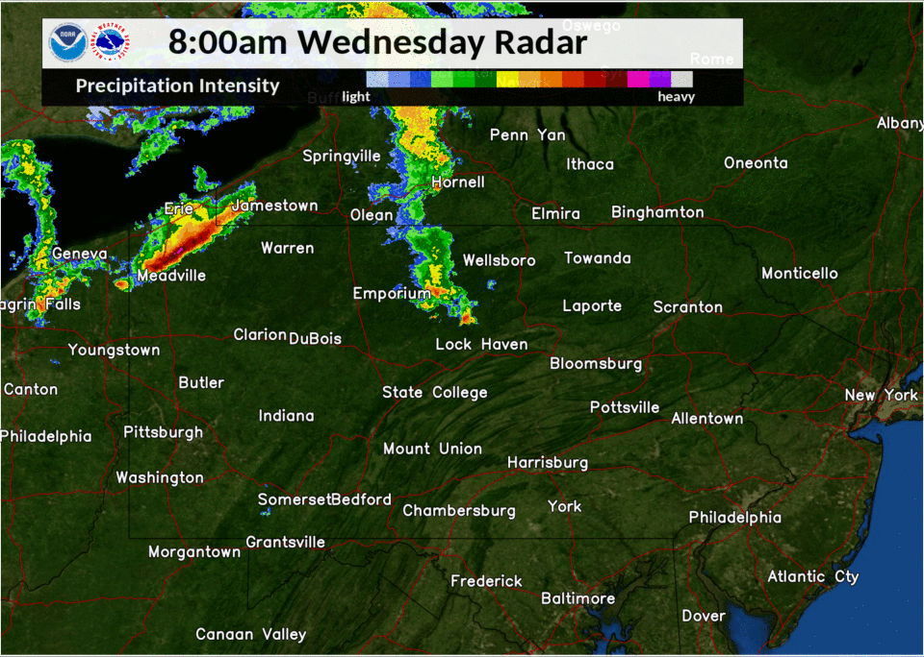
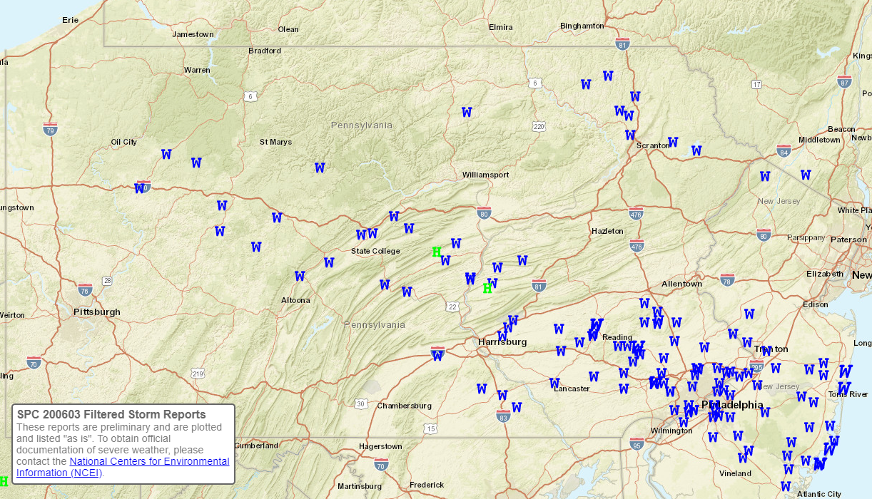
Derechos
Widespread, long-lived wind storm associated with a rapidly moving squall line or quasi-linear convective system
Must include wind gusts of 58+ mph along most of its length.
Must have several well-separated 75 mph wind gusts
Wind damage swath must extend more than 250 miles
June 3, 2020

Slide 46
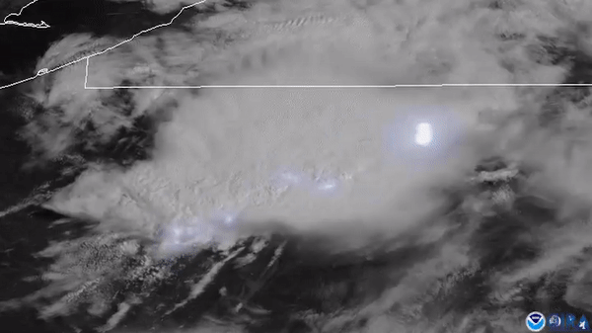
Derechos
Widespread, long-lived wind storm associated with a rapidly moving squall line or quasi-linear convective system
Must include wind gusts of 58+ mph along most of its length.
Must have several well-separated 75 mph wind gusts
Wind damage swath must extend more than 250 miles
June 3, 2020

Slide 47
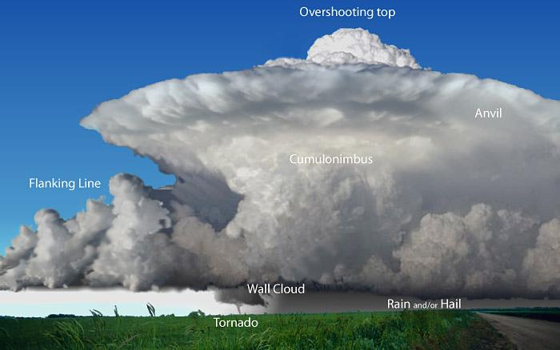
Supercell Thunderstorms
Supercell Thunderstorm
Characterized by rotating updrafts that can attain vertical velocities over 100 mph
Supercells are responsible for producing the most extreme severe weather, including giant hail and violent tornadoes
Downdrafts can produce downbursts/outflow winds in excess of 100 mph.
Increased risk for tornadic supercells when winds turn clockwise with height (veering).
Notes:
https://www.weather.gov/jetstream/life

Slide 48
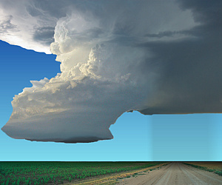
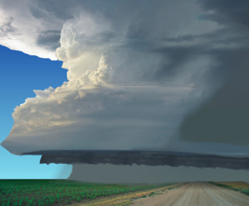
Types of Supercell Thunderstorms
Low-Precipitation (LP) Supercell
High-Precipitation (HP) Supercell

Slide 49
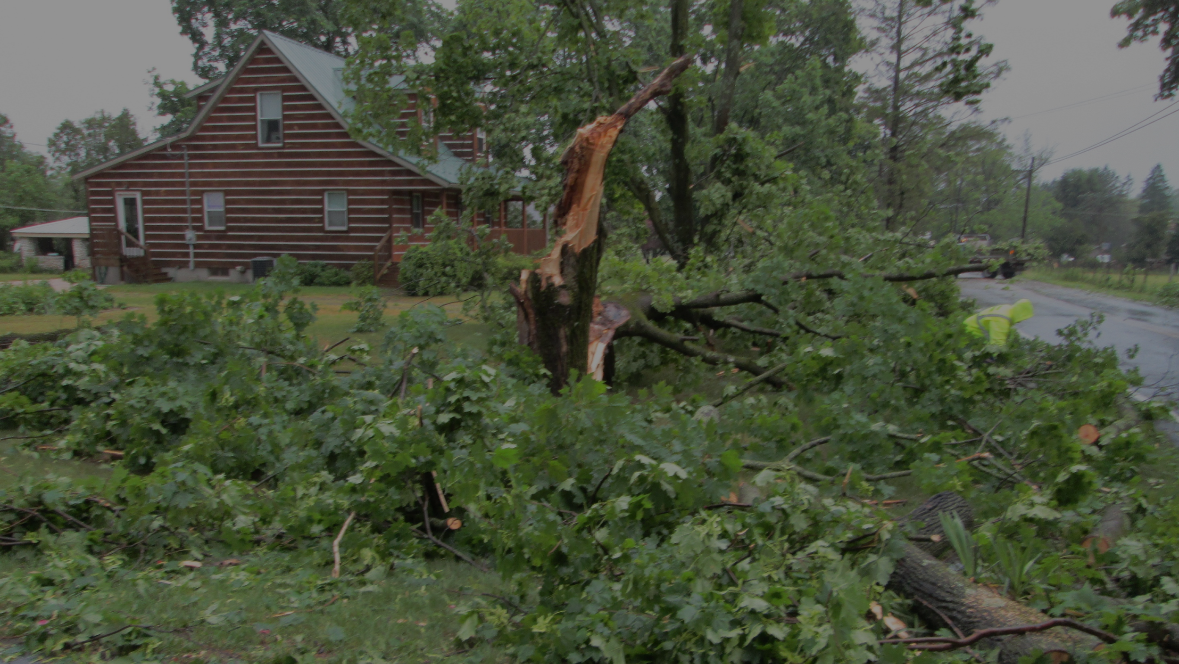
Thunderstorm Hazards

Slide 50
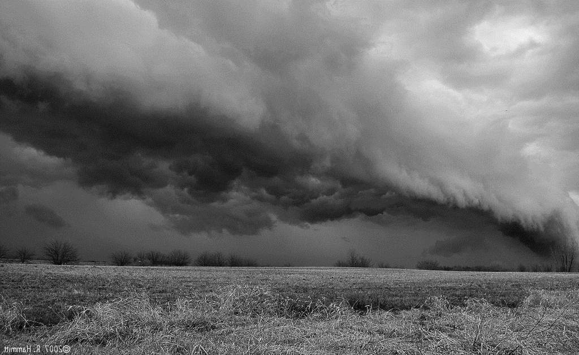
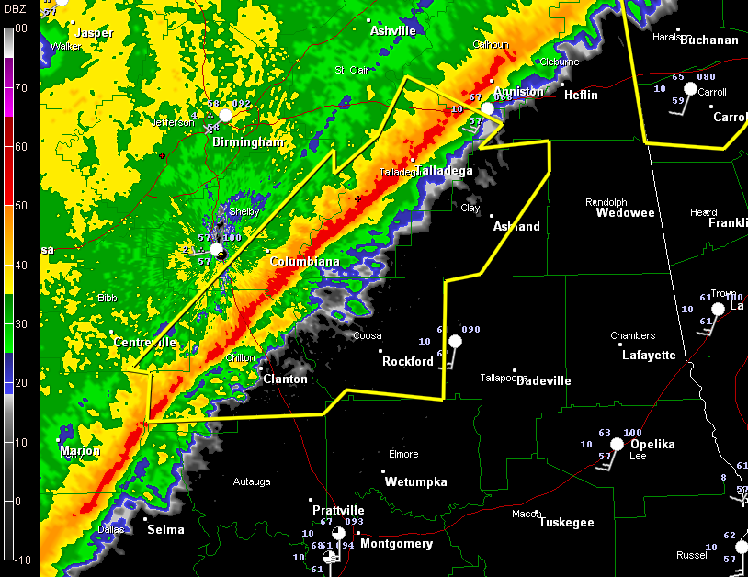
Straight Line Winds
The most common type of wind damage we see here in Pennsylvania
Result from a combination of the storm’s forward motion, the transport of momentum from strong wind aloft, and the generation of storm-relative outflow as a downdraft descends to the ground
Winds produce damage generally in a single direction, oriented parallel to the direction the storms were coming from
Straight line winds may occur ahead of the actual “storm” at the leading edge (or gust front)

Slide 51
Straight Line Winds
+
35 mph
winds at
5000 feet
=
Downdraft-
Enhanced Winds
Surface wind gusts of 65 mph

Slide 52
Straight-line wind event May 15, 2018

Slide 53
Straight Line Winds
Damage shows
a clear
UNI-
DIRECTIONAL
pattern
STRAIGHT LINE WIND “footprint”

Slide 54
Shelf Cloud
A low, horizontal wedge-shaped cloud associated with a thunderstorm gust front (or occasionally with a cold front, even in the absence of thunderstorms).
Rising cloud motion often can be seen in the leading (outer) part of the shelf cloud, while the underside often appears turbulent, boiling, and wind-torn.
If a shelf cloud becomes detached from the parent thunderstorm (e.g., in an outflow dominant storm) it becomes a roll cloud.

Slide 55
Downbursts
Downburst
Strong straight-line winds caused by an exceptionally strong downdraft, where cold, dense air descends from above, hits the ground, and spreads out at the surface
Downburst winds can exceed 100 mph!
Microburst – Downburst wind damage covering an area 2.5 miles or less
Macroburst – Downburst wind damage covering an area more than 2.5 miles

Slide 56
From Dr. Leigh Orf, University of Wisconsin - Madison

Slide 58
Downburst
Damage shows a clear
DIVERGING
pattern
DOWNBURST “fingerprint”

Slide 59
June 4, 2020
New Oxford, Adams County, PA

Slide 60
Tornado
A rapidly rotating column of air in contact with the ground, attached to the base of a thunderstorm or convective shower
About 1 in 10,000 thunderstorms produce a tornado
Tornadoes usually produce a very small and defined area of damage (swath/path)
Remember: the amount of damage does not indicate whether or not there was a tornado!
Notes:
15

Slide 61
Poll Question
On average, how many tornadoes occur in Pennsylvania each year?
0-10
10-20
20-30
30-40
Notes:
15

Slide 62
Poll Question
On average, how many tornadoes occur in Pennsylvania each year?
0-10
10-20
20-30
30-40
Answer:15
Notes:
15

Slide 63
April 2019 – A record breaking month

Slide 64
A look at a Tornado on Doppler Radar
When radar samples a tornadic thunderstorm, it typically samples a rapidly rotating mesocyclone, not the tornado vortex itself
Rare exception: when a tornado passes very close to a radar
Radar

Slide 65
Tornadoes – Some Terms
Wall Cloud – A lowering (and often rain-free) section of a thunderstorm, indicative of a strong updraft
A rotating wall cloud can be a sign that conditions within the storm are right for producing a tornado
But what are the low-level conditions below the storm?
Typically smaller than a shelf cloud
A Wall Cloud, while looking impressive, is not causing damage!

Slide 66
Funnel Cloud
Funnel Cloud – Fast spinning funnel descending from the thunderstorm cloud...but not yet reaching the ground
Rotation is the key!
Sign that conditions within the storm are right for producing a tornado
Again, what about conditions
below the storm?
A Funnel Cloud, while looking very impressive, is NOT causing damage.
But it may become a tornado soon!

Slide 67
A Couple Tornado Videos

Slide 69
Tornado Damage
Damage shows a clear
CRISS-CROSS pattern of convergence
TORNADO “footprint”

Slide 70
Tornado Damage
Damage shows a clear CONVERGENT pattern
TORNADO “footprint”
Damage shows a clear CYCLONIC turning
TORNADO “footprint”

Slide 71
Tornado Damage– Oct 2, 2018

Slide 72
Poll Question
What would you report to the NWS if you saw this?
Nothing
Tornado
Damaging Winds
Funnel Cloud

Slide 73
Flooding/Heavy Rain
Photo: Mike Brulo

Slide 74
River Flooding
Forecasts handled by the River Forecast Center
These are for specific, gauged locations along Main Stem Rivers and large tributaries
Locations where it takes more than 6 hours for the waterway to respond to heavy rainfall
Many streams and creeks are ungauged, and are covered by Flood and Flash Flood products
River Forecasts are driven by....
Time of Year (foliage)
Routing of upstream water
Reservoir and Dam releases
water.weather.gov
Click on your location on the map

Slide 75
River Flooding
Forecasts handled by the River Forecast Center
These are for specific, gauged locations along Main Stem Rivers and large tributaries
Locations where it takes more than 6 hours for the waterway to respond to heavy rainfall
Many streams and creeks are ungauged, and are covered by Flood and Flash Flood products
River Forecasts are driven by....
Time of Year (foliage)
Routing of upstream water
Reservoir and Dam releases

Slide 76
Flash Flooding

Slide 77
Areal Flooding
Slower Rises on small (ungauged) streams and creeks
Mainly driven by...
Slow moving, prolonged rain events
Repeated rainfall over the same area
Situations where streams and creeks respond after several hours of rain
More of a threat to PROPERTY than LIFE

Slide 78
Spotter Reporting Guidelines

Slide 79
Poll Question
True or False: It is safe to chase storms, especially at night
a. True
b. False

Slide 80
Poll Question
True or False: It is safe to chase storms, especially at night
a. True
b. False

Slide 81
What a spotter IS
What a spotter ISN’T
Observes the weather
Communicates
Stays safe!
Critical role in helping the National Weather Service and local officials
Storm chaser (though almost all storm chasers are spotters!)
An NWS meteorologist
Above the law
Immune to the laws of physics

Slide 82
What to Report
Time
When did it occur?
Location
Where? (Unsure? Give us a nearby intersection or landmark and we’ll figure it out!)
Condition
What are you reporting?
Source
Who are you?
“Hi, this is John. I’m one of your spotters and I’m calling to report hail. I’m located in Lancaster City and we’ve got at least quarter size hail falling right now, maybe larger.”

Slide 83
Reporting Tips
Late reports are okay (but please call us on the phone as soon as you can safely do so if you see a tornado)
We really appreciate your pictures and videos
Please remember to tell us where you are, even if it’s just a highway and a city reference
Time
Location
Condition
Source
“Yo, it’s getting dark here! Looks like it might be a tornado!”

Slide 84
Storm Reports for the National Weather Service
Time
When did it occur?
Wind Damage
Hail
Tornadoes and Funnel Clouds
Flooding
Location
Where? (Unsure? Give us a nearby intersection or landmark and we’ll figure it out!)
Matthew Kendall
Uprooted or downed trees
Large branches down
Wires down
Damaged infrastructure
Include photos if possible
Venango County, PA
Chris Kelley
Hail of any size
Please measure hail with a ruler or a common object for accurate sizing
If possible, measure the weight and include photos
Tish Evans
Any significant (uncommon) flooding
Water over roads
Streams rising to near bank full
Include photos if possible
Condition
What are you reporting?
Visible rotation in a wall cloud
Funnel cloud
Tornado
Include photos if possible
Source
Who are you?

Slide 85
Storm Reports for the National Weather Service
Time
When did it occur?
Snow
Sleet
Freezing Rain
Snowfall – During the Storm (nearest 1/10 of an inch)
Report when accumulations reach thresholds
Snowfall – Storm Total (nearest 1/10 of an inch)
Report as soon as you can after the storm ends
Snow Depth – TOTAL snow on the ground (nearest inch)
Might be the result of multiple storms
Remember, snowfall ≠ snow depth
Snowfall RATES
1 inch or more per hour (that’s pretty heavy snow!)
Visibility restrictions below ¼ mile
Location
Where? (Unsure? Give us a nearby intersection or landmark and we’ll figure it out!)
Any occurrence
Measuring on branches is easiest
Tougher on sidewalks, driveways
Remember to divide by 2 if measuring total ice accumulation on a branch!
Condition
What are you reporting?
Any occurrence and any accumulation
Source
Who are you?

Slide 86
How to Report
UNLISTED:
800-697-0010
LISTED:
814-954-6440
@NWSStateCollege
#PAwx
US National Weather Service
State College, PA
ctp.stormreports@noaa.gov

Slide 87
How to Receive Weather Alerts
Select which alerts you want to receive (recommendations shown here)
Choose whether you want to be alerted for a point (town), county, or custom-drawn polygon
https://inws.ncep.noaa.gov

Slide 88
NWSChat
NWS
Blue
EMs
Red text on white background
Media
Green
Transportation
Yellow
Others
Purple
ctpchat

Slide 89
NWSChat
https://nwschat.weather.gov

Slide 90
NWSChat
https://nwschat.weather.gov
Please give your affiliation & jurisdiction

Slide 91
Hazardous Weather Action Plan

Slide 92
Amateur Radio
NWS State College Call Sign: WX3CTP
We can monitor most of the frequencies listed from the office.
ACTION ITEM: build out contact database for amateur radio throughout the NWS State College weather forecast area.
Want point of contact for each county
EM or Skywarn/Amateur Radio group
Best way to do this?

Slide 93
Upcoming Spotter Talks

Slide 94
Weather-Ready Nation Ambassadors

Slide 95
What’s next?
EMAIL WILL BE SENT OUT TOMORROW
What to expect:
Are you a spotter already?
Contact Information
Course Evaluation
NOT A SPOTTER YET?
You’ll receive a spotter confirmation letter.
Please be patient as we process 200+ registrants.

Slide 96
A note about spotter IDs
We are discontinuing issuance of Spotter IDs
If you already have one – you can keep!
If you don’t have one yet, we’ll just ask for your name!

Slide 97
SKYWARN Registration and Course Evaluation
Please scan the QR code to complete your SKYWARN registration.
We also appreciate any and all feedback about the course. Negative or positive, don’t be shy!
Notes:
https://docs.google.com/forms/d/e/1FAIpQLSf9b0T4ygO9uiOEgyBBFNARRUshPagnszj-QO9x0-hxehqAvw/viewform

Slide 98
Thank You!
@NWSStateCollege
NEW!
@NWSStateCollege
/NWSStateCollege
/NWSStateCollege
ctp.stormreports@noaa.gov
www.weather.gov/ctp

Slide 99
Any
Questions?

